Slide 1
Booking a musician app
usability study
18.8.2021
Presentation #2
Study team for UX
Jaroslava Otmanová

Slide 2
Table of Contents
Section 1 Themes
Section 2 Before & After
Section 3 Recommendations

Slide 3
Previously on the presentation...
Background:
We are creating a booking app to book a musician for a wedding venue. Booking should be clear and fast. Users should have the ability to verify the musician.
Most important insights:
2 users had trouble to find a filter
Most of the users had difficulty to select a row with the filtered musician

Slide 4
Themes

Slide 5
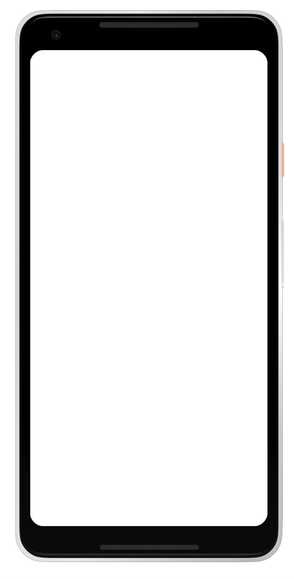
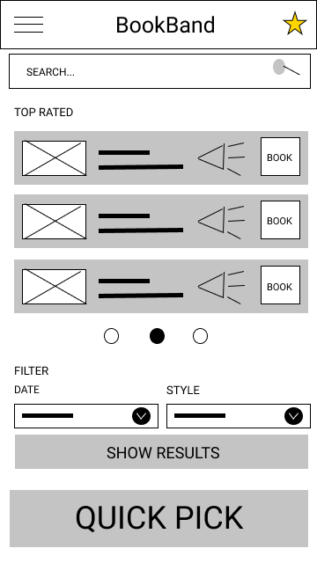
Most people did not know how or where to find the filter
Supporting evidence from the usability study.
2 out of 5 participants had trouble finding the filter
Two participant were really confused about the filter.
“What should I select? Should I filter from those top rated?”
a

Slide 6
Before & After

Slide 7
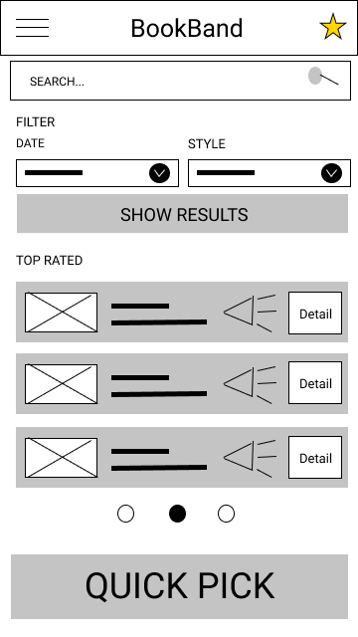

Slide 9
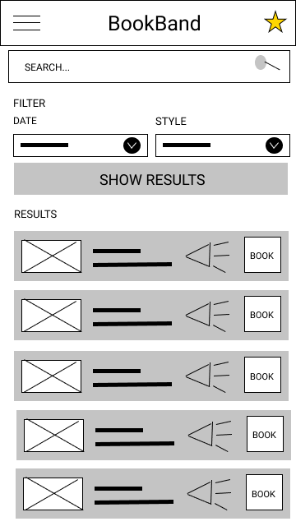


Slide 10
Recommendations

Slide 11
Recommendations
Integrate new updates on the prototype into a short updated research and study
After an updated study and new insights, create a high level prototype

Slide 12
Thank you!

